Slide 1

[Your Name]
2025–26
Guide: [Guide Name & Designation]
Hallucination Detection and Correction in
Large Language Models
A Research Proposal

Slide 2

Research Proposal
2025–26
Hallucination in LLMs
Problem Statement
Large Language Models such as GPT, LLaMA, and Gemini frequently generate fluent but factually incorrect text — called hallucination. This occurs when output contains false, misleading, or unverifiable information not grounded in training data or context.
Key Challenges:
Serious risks in healthcare, legal, and education domains
Current LLMs lack reliable detection mechanisms
Urgent need for systematic identification and correction

Slide 3

LLM Research Proposal
03
Hallucination Detection & Correction
Research Objectives
01
Study and categorize hallucination types produced by LLMs (intrinsic vs. extrinsic)
02
Survey and evaluate existing hallucination detection techniques and their limitations
03
Propose an automated detection methodology combining fact-checking, RAG, and confidence scoring
04
Design a correction mechanism to replace or flag hallucinated content with verified information

Slide 4


LLM Hallucination Research
2025–26
Research Proposal
Literature Survey
Key prior work and identified research gaps:
04
Ji et al. (2023): Comprehensive NLG hallucination survey, no detection framework
05
SelfCheckGPT & FActScoring: Effective but computationally expensive
06
Kadavath et al.: Self-evaluation via prompting, unreliable for complex claims
Gaps: Domain-specificity, no real-time correction, high latency, no unified pipelines.

Slide 5
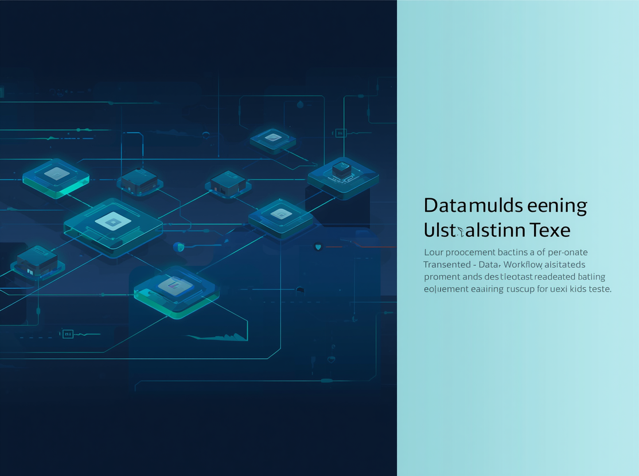
Research Proposal
2025–26
Hallucination Detection in LLMs
Proposed Methodology
Input Layer → Claim Extraction → RAG → NLI → Scoring → Correction → Output
01
RAG Retrieval & NLI Entailment
02
Confidence Scoring Module
03
Correction & Output Layer
Models: LLaMA/GPT-4 (Base), DPR/BM25 (Retrieval), RoBERTa-NLI (Entailment)

Slide 6

Research Proposal
2025–26
Hallucination Detection in LLMs
Tools & Technologies Used
Programming Language: Python 3.10+.
Base Models: LLaMA 2, GPT-3.5, Mistral.
NLI Models: RoBERTa, DeBERTa for entailment verification.
LLM Frameworks:
Hugging Face Transformers, LangChain
Retrieval:
FAISS, BM25, Elasticsearch
Evaluation:
TruthfulQA, HaluEval, MS-MARCO

Slide 7

Research Proposal
2025–26
Hallucination Detection in LLMs
Expected Outcomes
Anticipated deliverables and impact:
01
Functional detection-correction pipeline with reduced hallucination rates
02
Labeled benchmark dataset and confidence scoring dashboard
03
Research publication and demonstrated applicability in medical QA
These outcomes will advance reliable AI systems for critical applications.

Slide 8

Questions & Discussion Welcome
2025–26
Hallucination Detection in LLMs
Thank
You

